Slide 1
MATH 323
Graph Theory
Cr. 3
Lecture 5
April 22, 2015
Dr. Bhadra Man Tuladhar
MATH 323 Graph Theory Lec. 5

Slide 2
K-cube (Hypercube)
Let k ≥ 1. Consider the set B^{k} of all binary sequences of length k. For instance, B³ = {000; 001; 010; 100; 011; 101; 110; 111}. Let Q^{k} be the
graph (called the k-cube) with V(Q^{k}) = B^{k} , where uv ∈E(Q^{k}) if and only if the sequences u and v differ in exactly one place.
010
110
K-cube is an architecture for parallel computers, processing units can communicate directly if they correspond to adjacent vertices in Q_{k}.
011
111
Q^{k}
001
101
000
100
MATH 323 Graph Theory Lec. 5

Slide 3
What kind of graph is k-cube?
The k-cube is bipartite.
The weight of a 0,1-vector is the number of 1’s. Every edge of Q^{k} consists of a vector of even weight and a vector of odd weight. Hence the vectors of even weight form an independent set, as do the vectors of odd weight.
MATH 323 Graph Theory Lec. 5

Slide 4
What kind of graph is k-cube?
The k-cube is k-regular.
For each binary sequence i₁i₂ …i_{k}, there are k sequences that differ from this in one place. It is not dificult to verify that, V(Q^{k}) = 2^{k} and E(Q^{k}) = k. 2^{k-1}.
MATH 323 Graph Theory Lec. 5

Slide 5
Examples
  1. For the given graph, find:
  a. Degree and parity of each vertex
  b. Verify the theorem on degree of vertices & number of edges.
v₂
v₁
v₃
v₅
v₄
MATH 323 Graph Theory Lec. 5

Slide 6
Exercise (Contd.)
2. Draw the graphs:
a. K₈ and K_{3,5}
b. 3-regular with 7 vertices
3. Find all the paths from a to e in the graph given below:
d
b
c
e
a
g
f
MATH 323 Graph Theory Lec. 5

Slide 7
Exercise (Contd.)
Find a 4-regular graph G that has the
following graph as an induced subgraph.
MATH 323 Graph Theory Lec. 5

Slide 8
Exercise (Contd.)
5. Are these two graphs isomorphic?
h₆
h₅
v₃
v₁
v₄
v₅
h₁
h₃
v₆
v₂
h₄
h₂
G
H
6. Find all automorphisms of the graph G.
MATH 323 Graph Theory Lec. 5

Slide 9
Exercise (Contd.)
7. Qualify the following two graphs:
b
1
5
a
c
2
4
3
e
d
MATH 323 Graph Theory Lec. 5

Slide 10
Exercise (Contd.)
8. Suppose there are 6 chemicals c₁, c₂, … , c₆ some of which react with each other, if put in the same container:
c₁ reacts with c₂ and c₄, c₂ reacts with c₁ and c₆,
c₃ reacts with c_{4,} c₅ and c₆, c₄ reacts with c₁ and c₃,
c₅ reacts with c₃, c₆ reacts with c₂ and c₃.
What is the least number of containers you need in order to transport the chemicals safely?
MATH 323 Graph Theory Lec. 5

Slide 11
Check!
How many digits does 100! have?
Which is larger, n! or 2^{n}?
For 100: 100! > or < 2¹⁰⁰
^{Tell me next time, OK?}
^{This time, Yes!}

Slide 12
Check!
How many digits does 100! have? (158)
Which is larger, n! or 2^{n}?
For 100: 100! > or < 2¹⁰⁰
^{Tell me next time, OK?}
^{This time, Yes!}

Slide 13
Check!
How many digits does 100! have? (158)
Which is larger, n! or 2^{n}? (n! is larger than 2^{n})
For 100: 100! > or < 2¹⁰⁰
^{Tell me next time, OK?}
(158 digits) > (31 digits)
^{This time, Yes!}

Slide 14

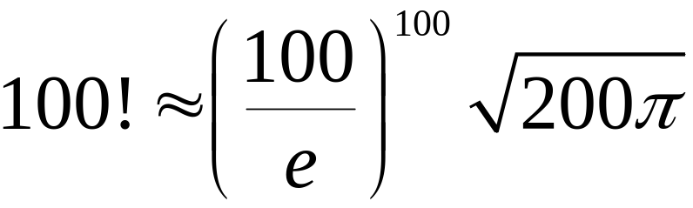
Stirling’s Formula
Stirling’s Formula:

Slide 15
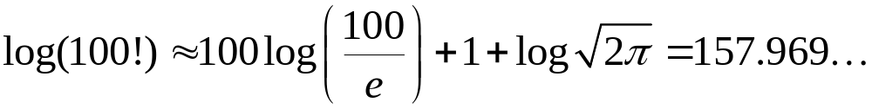
Stirling’s Formula
Stirling’s Formula:
The number of digits 100! is 158.

Slide 16
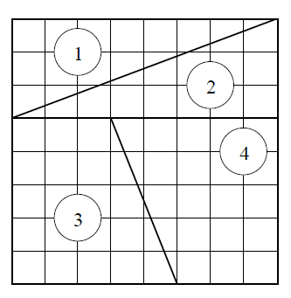
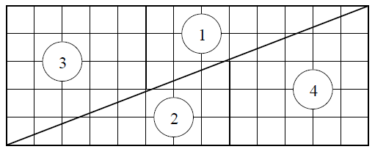
Believe It or Not
Area = 13 ∗ 5 = 65
Area = 8 ∗ 8 = 64
?

Slide 17
More Next Time
Tree
MATH 323 Graph Theory Lec. 5

